Slide 1

Sprint review Sprint: 25 – Team: CanNot…t
Confidential Material – For intended audience only and not for broad distribution

Slide 2


Content
The team
Sprint summary
Stories
UAT bugs
Burn down chart
Statistics
Documents
Notes:
30 min

Slide 3

The Team
Product Owner
Iwan Spillebeen
Scrum Master
Toon
Team
Thong
Tob
Tonge
Lek
KA
Med
Win
Waleed
Nanees

Slide 4
Sprint Summary
Sprint 25 Goals
Accomplishments
Committed functionalities: 35 US, 4 Non-US
Committed Story Points: 65 US
Additional : -2 US, 7 Non-US
UAT Faults: 0
Story points completed: 66 points
Completed: 32 US, 11 Non-US
Unfinished Stories: 0 US
Story points remaining: 0 points
Investigation of Mongo DB
Research angular 4
Start of product management module
Creation of GUID Provider to generate global IDs securely
Research how to code coverage on sonarqube
Notes:
The goals of the sprint are ….
Mongo DB
We research information about Mongo DB that if we use it to store our data is it appropriate (เออะ-โพรฺเพรียท) or not
what is the difference between HBase and MongoDB
Angular 4
We have to know more information about angular 4 that if we use its
What are the effects on us,
What are the pros and cons of it ?
What does it solve the problem of front-end for us ?
Product
We created pages for manage data of product so now we can see, add and update data product on manage console
Guid Provider
We finished the GUID Provider system for generate global IDs securely.
Code coverage
We research how to add the feature for check code coverage on sonarqube.

Slide 5
Sprint Stories
Sprint 25 Linked
Notes:
These are user stories that we did

Slide 6
Sprint Bugs/Problem
Lack of experience on front-end
Estimated time was wrong
Code conflict and lost when we work on the same file
Notes:
That make working slow and burn down chart was affected
เมื่อการทำงานช้าส่งผลให้ Burn down chart ออกมาไม่ดีนัก
Some user stories took more time
ทำให้รู้ถึงปัญหาว่าเราประเมิณเวลาผิด เช่น บาง user story ประเมิณไว้ 2 ชม แต่ทำจริง ๆ อาจจะใช้จริง ๆ 1 วัน
So waste times merging code.
เสียเวลาการ merge code
I will demonstrate (เด็มเมินซเตรฺท) how to adding and editing products.
After that I will show how to searching data products

Slide 7
Burn down chart
Notes:
5

Slide 8
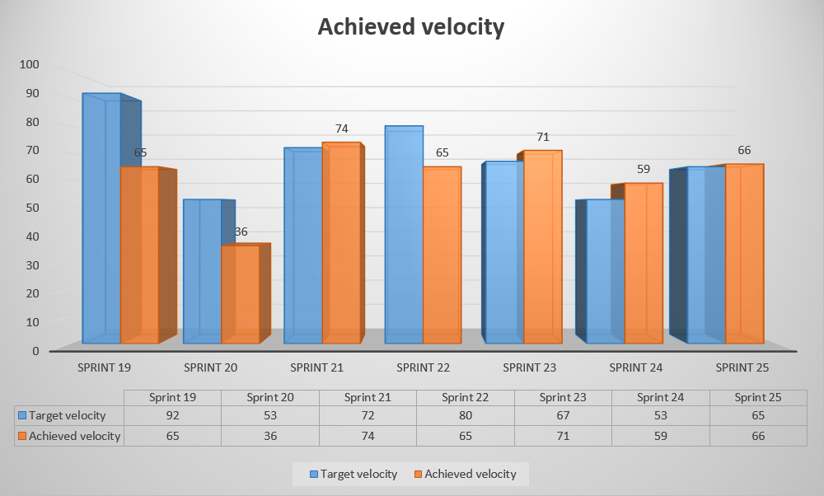
Sprint Statistics
Target velocity: 65 Achieved velocity: 66
Notes:
5

Slide 9
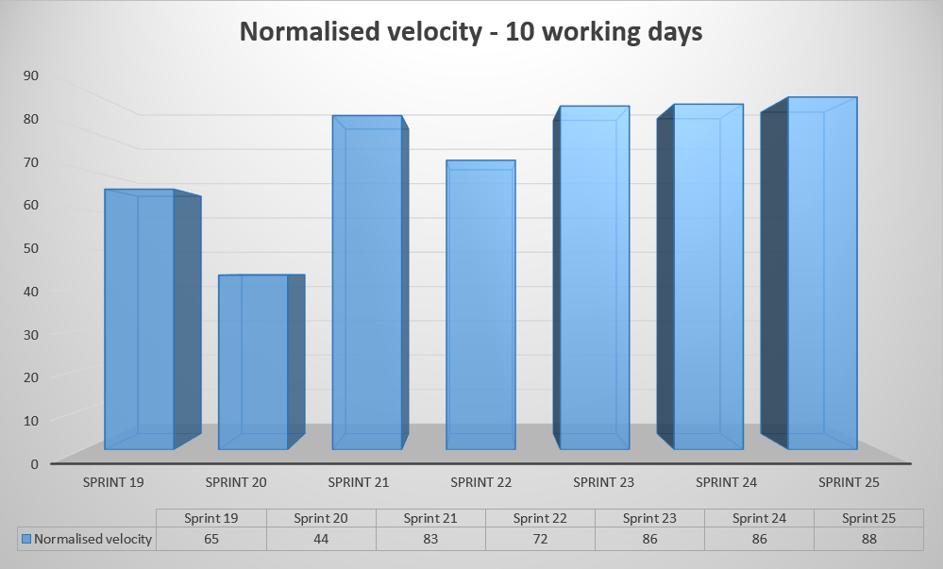
Sprint Statistics
Notes:
5

Slide 10
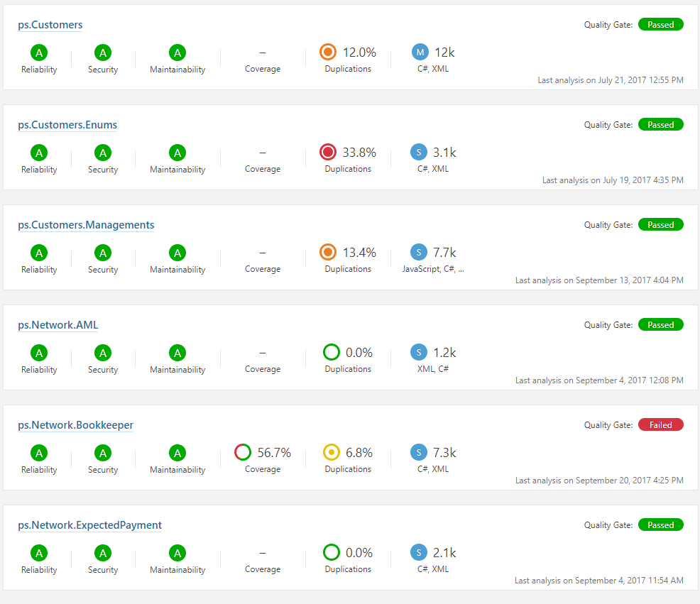
Quality Statistics
Notes:
5

Slide 11

Documents
Documents produced
Path:
Product
GuidProvider
Notes:
5

Slide 12
THANK YOU

